Slide 1

Industry: Aviation | Airline
Use Case: Predict the likelihood of flight cancellations or delays.
Team members:
Akhila Cherukupalli
Ankith Gundeboina
Claudia Calderas
Karthik Puppala
Preethi Mahankali
Tamanna Fatima Syeda

Slide 2

Ethics review
Ethical concerns:
Historical bias (Data set from 2003 to 2022)
Data privacy (Expose the airline carriers)
Use Case: Predict the likelihood of flight cancellations or delays.
Use Case Revised: Predict the likelihood of flight cancellations from 2018 to 2022 including all the air carriers that accepted to be part of the study.

Slide 3









Business Understanding
Data Understanding
Data Preparation
Modeling
Evaluation
Deployment
FRAMEWORK
CRoss
Industry
Standard
Process for
Data
Mining

Slide 4
Business Understanding
Canceled flights increased from 1.72% in 2021 to 2.69% in 2022 and this is generating a problem for customers that were not able to get to their destinations.
Our goal is to generate a model that provides the information to determine if a flight will get canceled or not.
The target variable for our project is arr_cancellations
With that information, consumers can make better decisions about which flights to book.

Slide 5

To predict the likelihood of flight cancellations or delays, we are employing certain machine-learning strategies.
https://www.transtats.bts.gov/ot_delay/OT_DelayCause1.asp?20=E was used to get our dataset which had 328207 records for 21 different variables.
The dataset contains data from 2003 to 2022.
Data
Overview

Slide 6
year: Year data collected.
month: Numeric representation of the month.
carrier: Carrier.
carrier_name: Carrier Name.
airport: Airport code.
airport_name: Name of the airport.
arr_flights: Number of flights arriving at the airport.
arr_del15: Number of flights more than 15 minutes late.
carrier_ct: Number of flights delayed due to air carrier. (e.g., no crew).
Data
understanding

Slide 7
carrier_ct: Number of flights delayed due to air carrier. (e.g., no crew).
weather_ct: Number of flights cancelled due to weather.
nas_ct: Number of flights delayed due to the National Aviation System (e.g., heavy air traffic).
security_ct: Number of flights canceled due to a security breach.
late_aircraft_ct: Number of flights delayed as a result of another flight on the same aircraft delayed.
arr_cancelled: Number of canceled flights.
arr_diverted: Number of flights that were diverted.
Data
understanding

Slide 8
Data
understanding
arr_delay: Total time (minutes) of a delayed flight.
arrier_delay: Total time (minutes) of delay due to air carrier.
weather_delay: Total time (minutes) of delay due to inclement weather.
nas_delay: Total time (minutes) of delay due to the National Aviation System.
security_delay: Total time (minutes) of delay as a result of a security issue.
late_aircraft_delay: Total time (minutes) of delayed flights as a result of a previous flight on the same airplane being late.

Slide 9
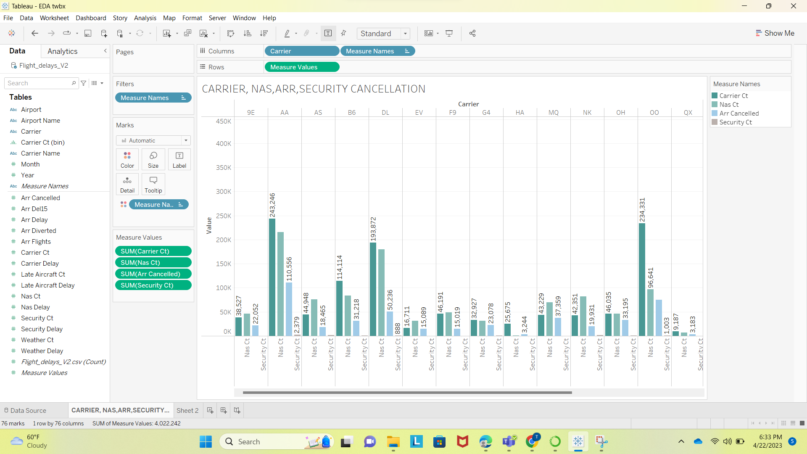
Nas Ct, Security Ct, Carrier Ct, and Arr Cancelled are the type of cancellations. From the below bar graph, we can see which carrier has the greatest number of cancellations and which type of cancellations.
Data
understanding

Slide 10
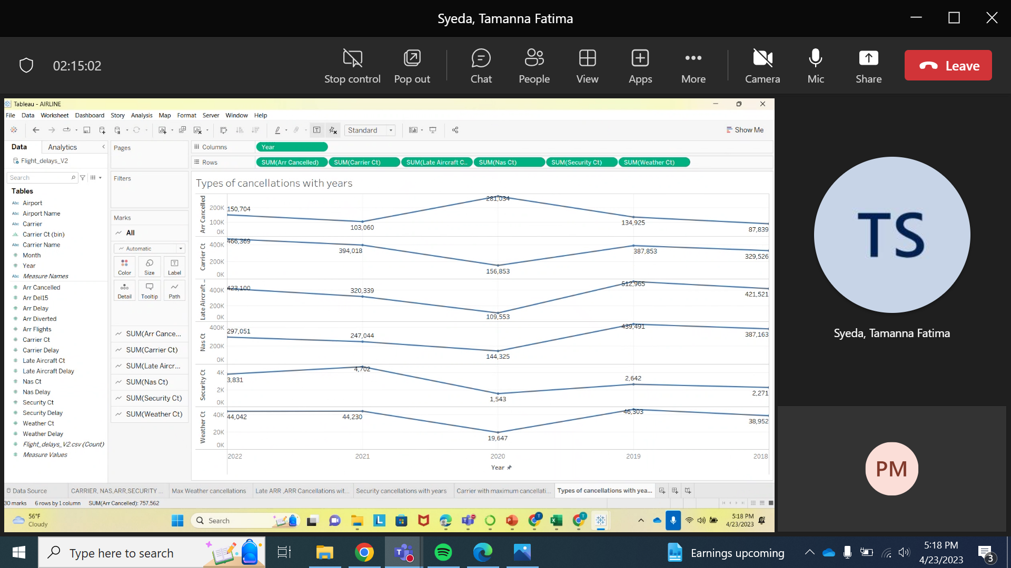
The below visualization is about the sum of cancellations like (Arr, Carrier, Late Aircraft, Nas, Security, and weather) with respect to the years 2018-2022.
Data
understanding

Slide 11
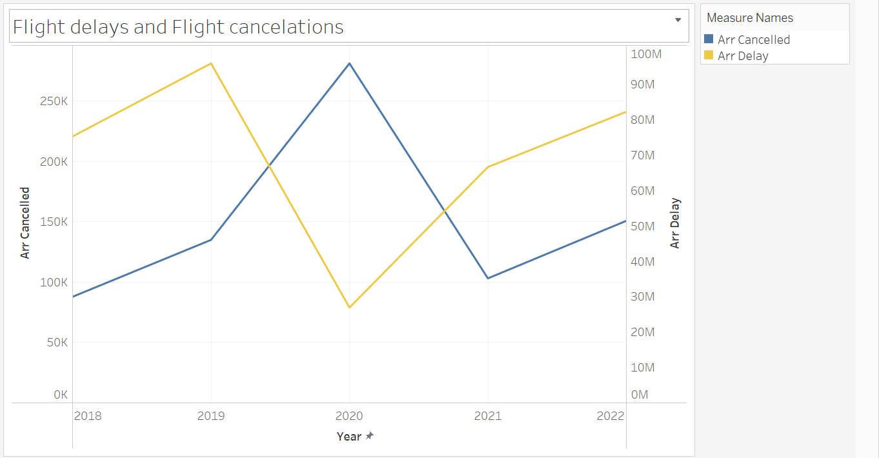
The graph below demonstrates no of flight delays and cancellations from the year 2018-2022.
Data
understanding

Slide 12
Data preparation is one of the essential phase before moving to modeling for making our dataset quality data we performed the following functions:
Cleaning data(Removed rows from 2003 to 2017 and removed the columns related to delays).
After removing rows and columns we had 95424 rows and 10 columns.
Checking for null values.
Dropping null values.
Reassigning the index values.
Replacing the numeric variables from our target variable to yes or no (0=‘NO’, >0 = ‘YES’)
Data Preparation

Slide 13
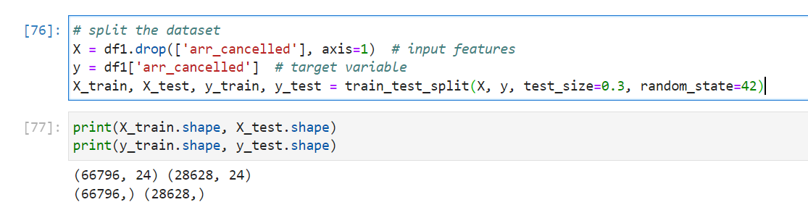

Later, to make our dataset completely prepared for modeling we are performing the following functions:
Encoding – Here we are replacing the categorical variables with numerical variables. We did Label Encoding and OneHotEncoding.
Train_test_split – For this part, we are splitting over dataset into two parts train and test.
Scaling- We are normalizing the data set that we split.
Data Preparation

Slide 14
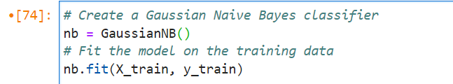
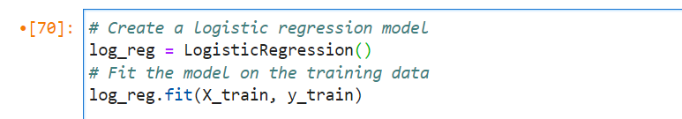
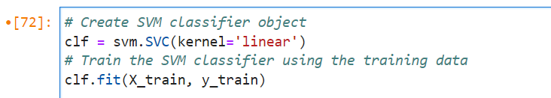
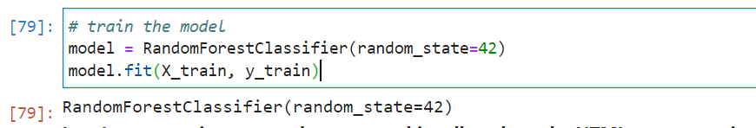
We used following Models for training our dataset.
GaussianNB
Logistic Regression
SVM
Random Forest
Modeling

Slide 15
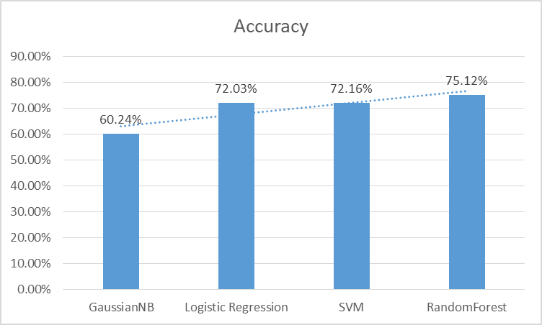
Evaluation
We have checked the accuracy using different models. The results show that the classification accuracy of the RandomForest was highest, which was about 75.12%.

Slide 16
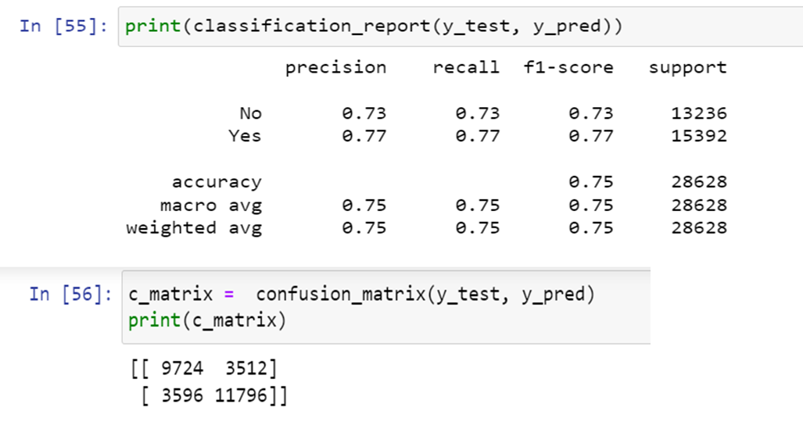
Evaluation
üAll four models' classification reports and confusion matrices have been examined. The representation of the same for RandomForest, the one with the highest accuracy among them, is shown below.

Slide 17

Deployment
However, we will not be using this model as we did not receive the anticipated level of accuracy.
THANK YOU

